Slide 1
Групповой проект
Групповой проект
H3K4me
Notes:
тут рассказываем про H3K4me в общем виде: ….
H3K9me - это гистоновая метка, которая обычно связана с гетерохроматином и репрессией генов. Она образуется путем метилирования лизина 9 на гистоне H3.
H3K9me может быть моно-, ди- или три-метилированной, и каждый из этих состояний может иметь различные функции. Например, H3K9me3 связывается с белками, которые репрессируют экспрессию генов, что приводит к сжатию хроматина и подавлению транскрипции.
H3K9me также может взаимодействовать с другими гистоновыми метками и белками, такими как HP1 (гомолог Дрозофилы гетерохроматина 1), которые помогают поддерживать гетерохроматическое состояние хроматина.
Некоторые исследования также связывают H3K9me с эпигенетическими изменениями в рамках различных заболеваний, таких как рак и неврологические нарушения.

Slide 2
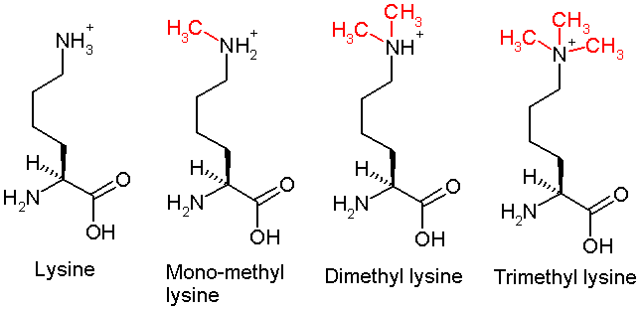
Methylation of lysine 4 of histone H3

Slide 3
Эпигенетическая модификация - Histone methylation
Лапшина Ксения | AIRE | Histone modification read, TF
Васильева Дарья | KMT2A | Histone modification write
Степанянц Максим | RAG2 | Histone modification read
Зарипов Данис | PHF8 | Histone modification erase
Ярцев Кирилл | ING4 | Histone modification read
Епифанов Евгений | ZCWPW1 | Histone modification read
Сильвестрова Анна | MLL2 | Histone modification write
Митурич Василий | TAF3 | Histone modification read
Сушкова Дарья | WDR5 | Histone modification read
Белова Наталья | CCDC101 | HIstone modification read

Slide 4

AIRE | “... AIRE selectively interacts with histone H3 through its first plant homeodomain (PHD) finger (AIRE–PHD1) and preferentially binds to non-methylated H3K4 (H3K4me0) … AIRE–PHD1 is an important member of a newly identified class of PHD fingers that specifically recognize H3K4me0 …” Org et al., 2008 “Certain posttranslational modifications of H3 tails, notably dimethylation or trimethylation at H3K4, abrogated binding by Aire, whereas others were tolerated.” Koh et al., 2008
KMT2A | “Histone lysine methyltransferase 2 (KMT2) proteins form multimeric enzymatic complexes that methylate lysine 4 on histone H3 (H3K4) at transcription regulatory elements in the genome” - doi: 10.1016/j.bbagrm.2020.194545 “KMT2A (MLL1) is responsible for generating mono-, di-, and tri-methylated H3K4 through its SET domain and by interaction with cofactors”-doi:10.2217/epi.15.1 “Of the many PHD fingers only PHD3 of KMT2A in KMT2 family exhibit H3K4 binding properties” - doi: 10.3390/cells7030017
RAG2 | RAG2 (Recombination activating gene) contains a plant homeodomain (PHD) near its C terminus (RAG2-PHD) that recognizes histone H3 methylated at lysine 4 (H3K4me) and influences V(D)J recombination. Two aspects of RAG2-PHD are unique. First, in the absence of the modified peptide, a peptide N-terminal to RAG2-PHD occupies the substrate-binding site, which may reflect an autoregulatory mechanism. Second, in contrast to other H3K4me3-binding PHD domains, RAG2-PHD substitutes a carboxylate that interacts with arginine 2 (R2) with a Tyr, resulting in binding to H3K4me3 that is enhanced rather than inhibited by dimethylation of R2. source
PHF8 (1, 2) | 1) PHD finger protein 8 (PHF8) belongs to the JmJc domain-containing family of proteins that can remove methyl groups from arginine or lysine residues (…) the identified H3K4me3 readers Sgf29, TRRAP, PHF8 (…) 2) PHF8 is associated with hypomethylated rRNA genes
ING4 | Full-length ING4 recognizes methylated H3K4 peptides, but an ING4 derivative lacking the PHD finger, ING4_{ΔPHD} (aa 1–194), does not, demonstrating that the PHD finger of ING4 is necessary and sufficient for the H3K4me peptide binding activity of ING4.
ZCWPW1 | Here, we demonstrate that Zcwpw1 is an H3K4me3 reader that is required for DSB repair and synapsis in mouse testes.
MLL2 | Here, we show that Mll2, one of the six Set1/Trithorax-type H3K4 methyltransferases in mammals, is required for trimethylation of bivalent promoters in mouse embryonic stem cells.
TAF3 | TAF3 contributes to promoter recognition and selectivity and acts as antiapoptotic factor. Further analyses show that H3K4me3 enhances p53-dependent transcription by stimulating preinitiation complex (PIC) formation; (…) H3K4me3-TAF3/TFIID interactions regulate geneselective functions of p53 in response to genotoxic stress.
WDR5 | “Here we show that … the WD40-repeat protein WDR5 directly associates with histone H3 di- and trimethylated at K4 and with H3-K4-dimethylated nucleosomes. WDR5 is required for binding of the methyltransferase complex to the K4-dimethylated H3 tail as well as for global H3 K4 trimethylation …” - doi: 10.1016/j.cell.2005.03.036
CCDC101 | “SGF29 (CCDC101) specifically recognizes and binds methylated 'Lys-4' of histone H3 (H3K4me), with a preference for trimethylated form (H3K4me3)... In the SAGA-type complexes, SGF29 is required to recruit complexes to H3K4me…”

Slide 5
В какие комплексы входят выбранные белки?
AIRE | Not found
KMT2A | MLL-HCF, CHD8, COMPASS-like MLL1,2
RAG2 | not found
PHF8 | PHF8-TOPBP1
ING4 | HBO1
ZCWPW1 | Not found
MLL2(KMT2D) | Set1/COMPASS,SWI/SNF (BAF),NuA4 (Tip60-p400) ,MLL2
TAF3 | TFIID
WDR5 | ATAC, NSL, RING2-L3MBTL2, MLL1/2, MLL3/4
CCDC101 | ATAC

Slide 6
Экспрессия (ткани)
Ген | Название ткани + медианный TPM
AIRE | GTEx Brain: Hypothalamus (4.017), Anterior cingulate cortex (1.691), Cortex (1.383), Frontal Cortex (1.305), Nucleus accumbens (basal ganglia) (1.152) NCBI Lymph node (0.592); Thymus (0.443); Adrenal (0.069), Lymph node (0.056), Brain (0.044)
KMT2A | GTEx: Brain - Cerebellum 34.84, Brain - Cerebellar Hemisphere 32.50, Ovary 26.88, Artery - Tibial 25.50, Uterus 24.74, Nerve - Tibial 21.77, Artery - Aorta 21.16,
RAG2 | В организме человека почти только в щитовидной железе (RPKM 16.6), но также понемногу в семенниках и костном мозге [ncbi]. По GTEx, есть на минимальном уровне везде, но в ощутимых размерах в щитовидной железе и немного в семенниках.
PHF8 | Testis (59.4), Ovary (30.1), Uterus (24.3)
ING4 | Brain cerebellar hemisphere 79.6, Brain cerebellum 76.35, Thyroid 69.97, Endocervix 67.59, Ectocervix 60.35, Uterus 60.29

Slide 7
Экспрессия (ткани)
ZCWPW1 | Testis(144.0)
MLL2 | adrenal gland (2.783),appendix (4.121 ),bone marrow (9.459),cerebral cortex (3.186 ),colon (4.104),duodenum (2.446 )endometrium (4.128 ) ,esophagus (2.945 ) ,adipose tissue(3.081) ,gall bladder (3.217),heart (2.105) ,kidney (3.749),liver (1.068) ,lung (3.531) ,lymph node (3.521),ovary (5.62) ,pancreas (1.316) ,placenta (4.067) ,prostate (3.391) ,salivary gland (1.87) ,skin (5.759) ,small intestine (2.624),spleen (5.17) ,tomach (3.076),testis (5.013),thyroid (4.12)
TAF3 | Артерия (16.29) - Мозг (14.95) - полушарие мозжечка (13.74)
WDR5 | Testis (95.45), Brain - Cerebellar Hemisphere (62.63), Brain - Cerebellum (59.44), Cells - Cultured fibroblasts (58.67), Cells - EBV-transformed lymphocytes (51.34) (Данные взяты из БД GTEx)
CCDC101 | Ubiquitous expression in testis (13.2) and ovary (12.9)

Slide 8
Доменная структура
AIRE
KMT2A
RAG2
PHF8
ING4
ZCWPW1
MLL2
TAF3
WDR5
CCDC101

Slide 9
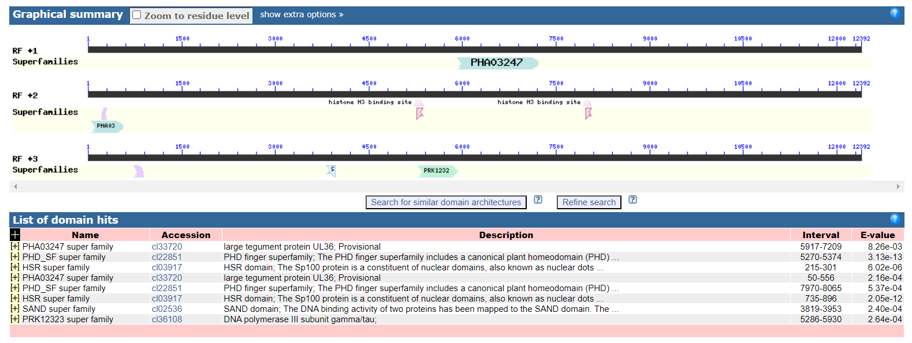
Доменная структура AIRE

Slide 10
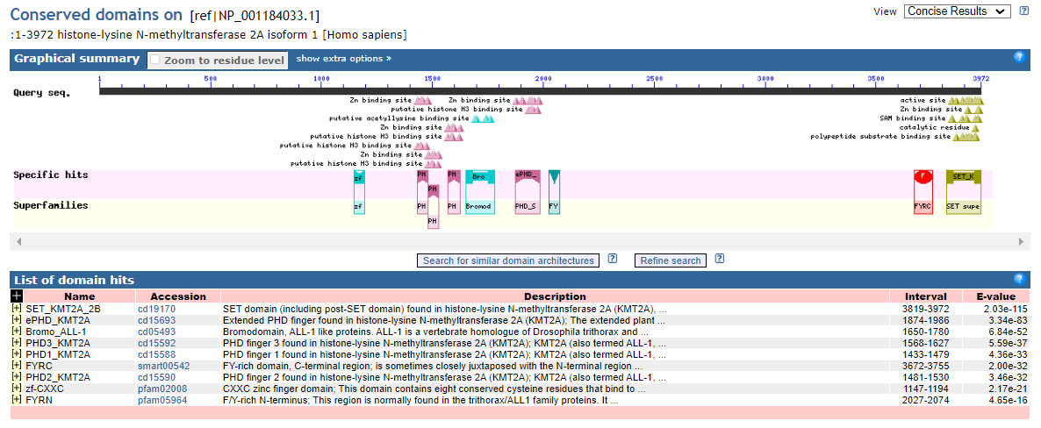
Доменная структура KMT2A

Slide 11
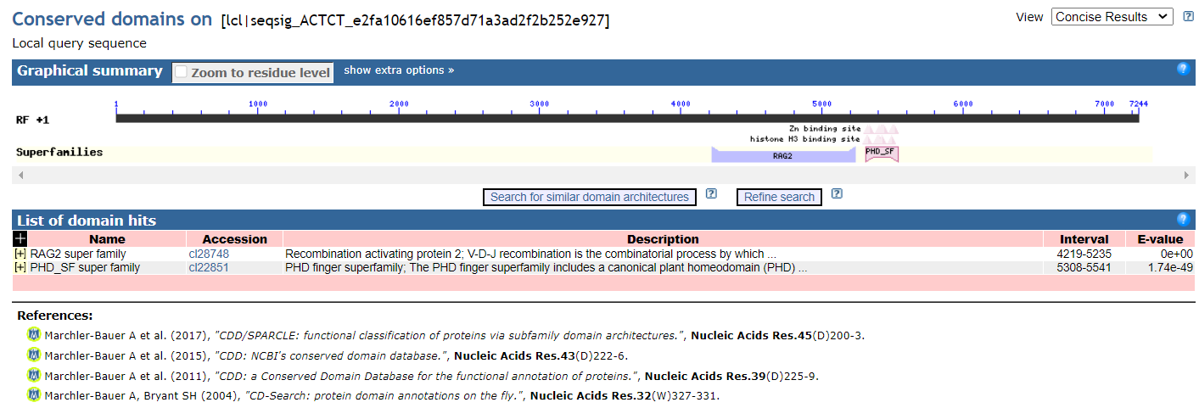
Доменная структура RAG2
Note: существует RAG1, но он выполняет другую эпигенетическую функцию, экспрессируется в других тканях. Генетическая общая в том, что Recombination activation (The protein encoded by this gene is involved in activation of immunoglobulin V-D-J recombination. The encoded protein is involved in recognition of the DNA substrate, but stable binding and cleavage activity also requires RAG2.)

Slide 12
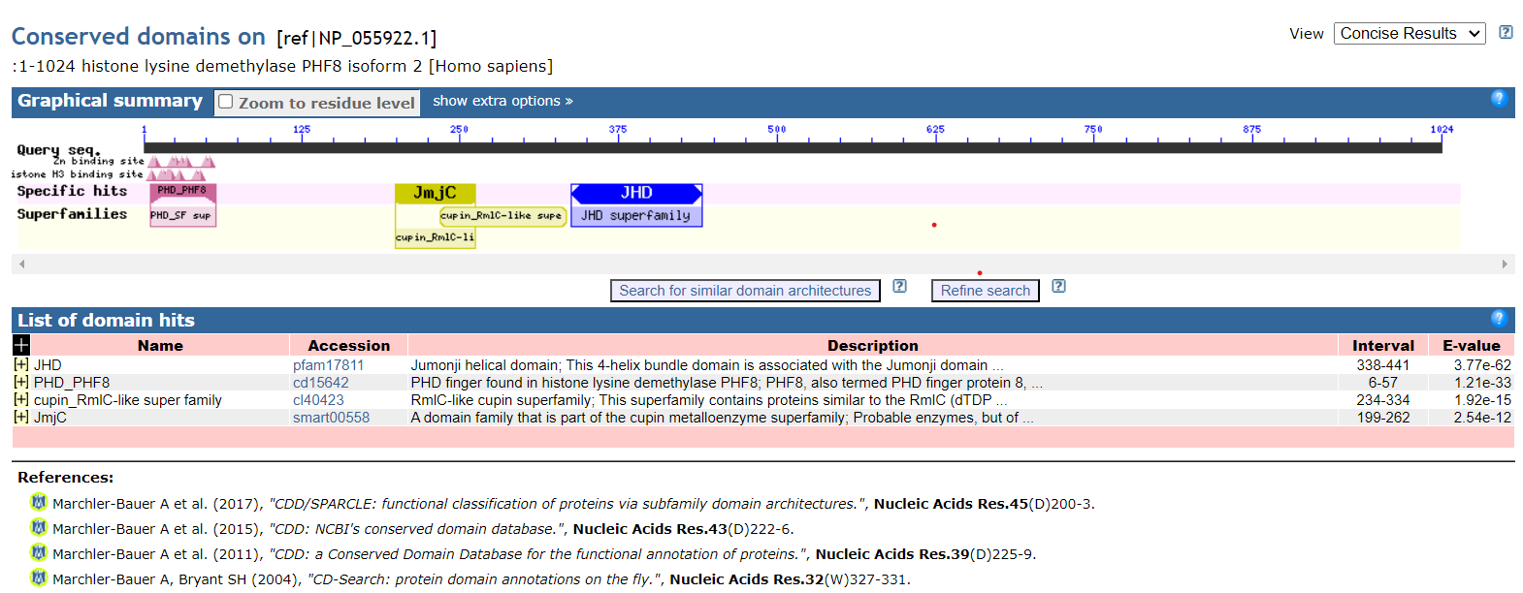
Доменная структура PHF8

Slide 13
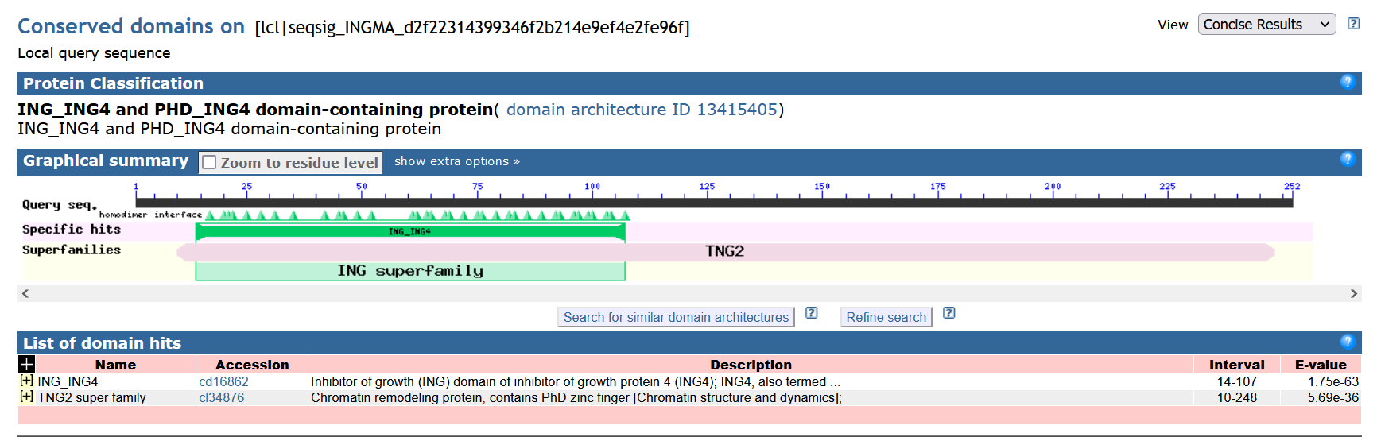
Доменная структура ING4

Slide 14
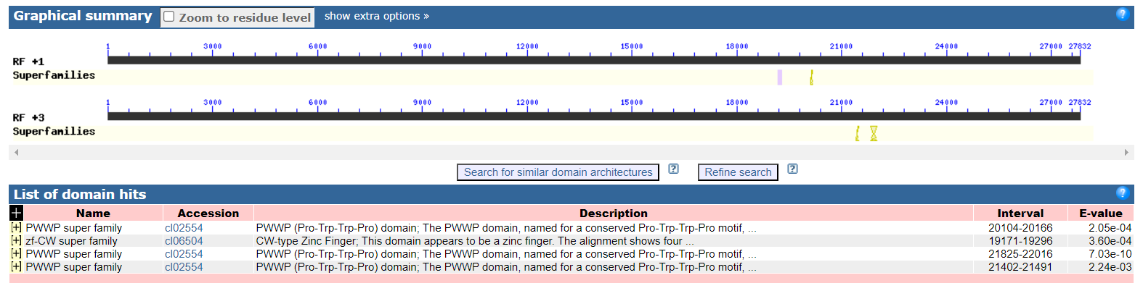
Доменная структура ZCWPW1

Slide 15
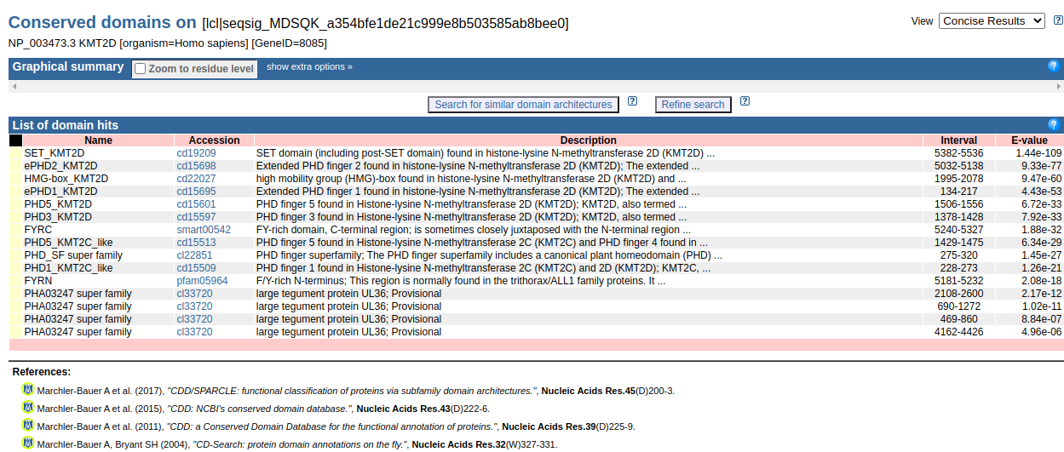
Доменная структура MLL2

Slide 16
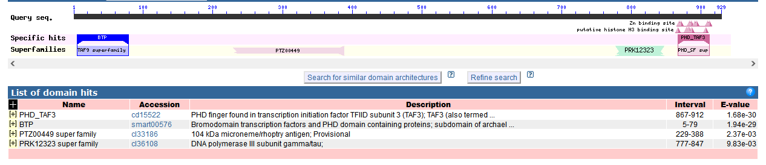
Доменная структура TAF3

Slide 17
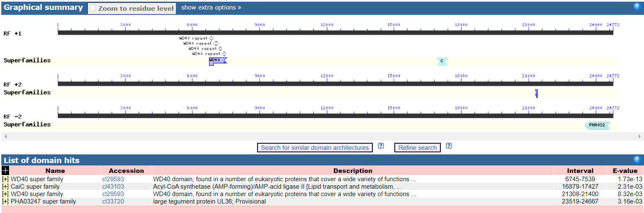
Доменная структура WDR5

Slide 18
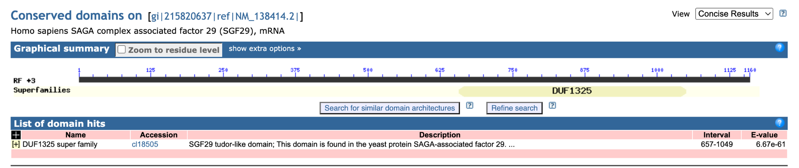
Доменная структура CCDC101

